Slide 1
Dr Horticulture v1.0
Team Members: Jose Nunez, Cesar Reyes Product Owner: Dr. Khoddamzadeh
Instructor: Masoud Sadjadi School of Computing and Information Sciences Florida International University
Final Presentation
Spring 2018
The logo of your project
Notes:
7 seconds.( I will select 2 best slides (i will give them extra points and students will present for CIS committee)
Greet your audience, thank them for attending your presentation, introduce yourself, introduce your project, introduce your team members, and quickly indicate what each of you did in a high-level manner, and put more emphasis on your part/contribution.

Slide 2
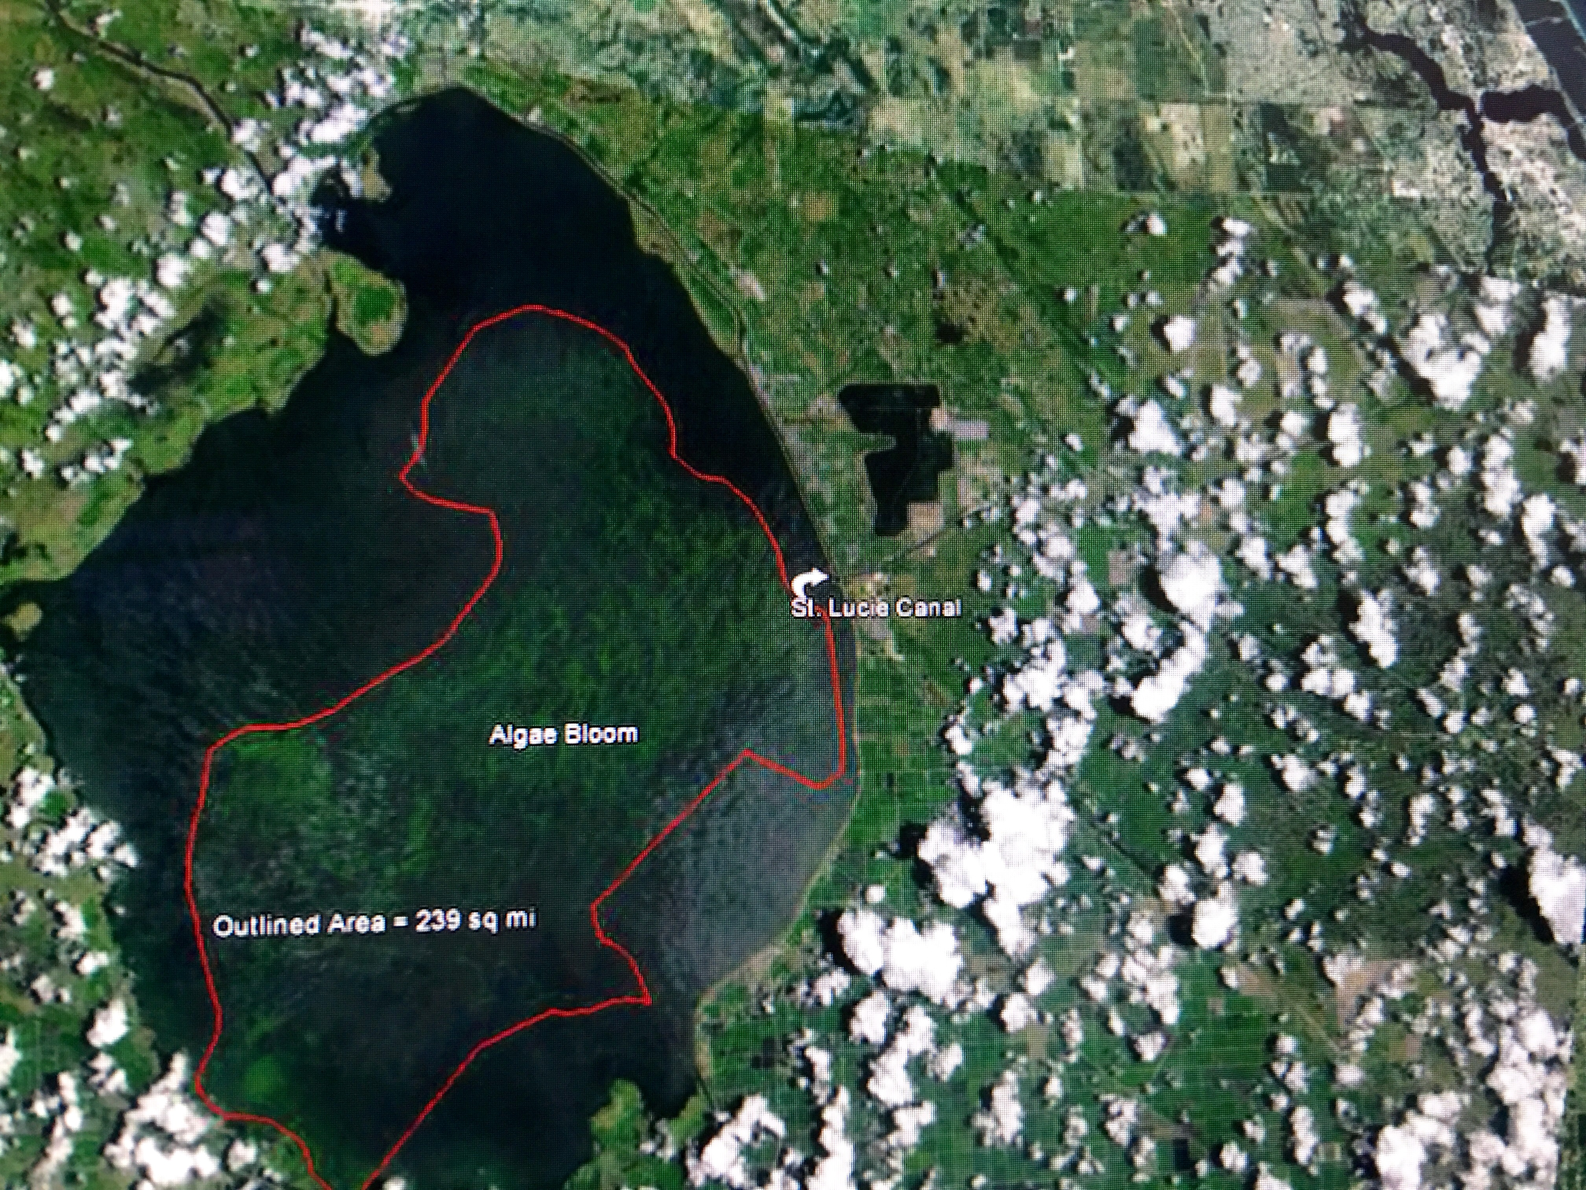
Project definition
Over fertilization Dangers and environmental impact:
Algal bloom in Lake Okeechobee, FL, July 2017
Notes:
20 seconds.
Introduce the problem that the your project (in new version) tackles with GIF or screenshot.

Slide 3
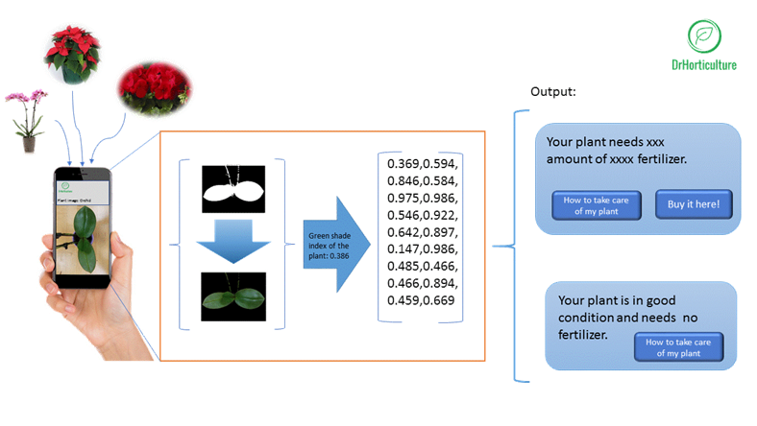
Project definition
Dr Horticulture app; The solution to over fertilization:
Notes:
10 seconds.
Introduce the problem that the whole project (in all versions) tackles with GIF or screenshot.

Slide 4
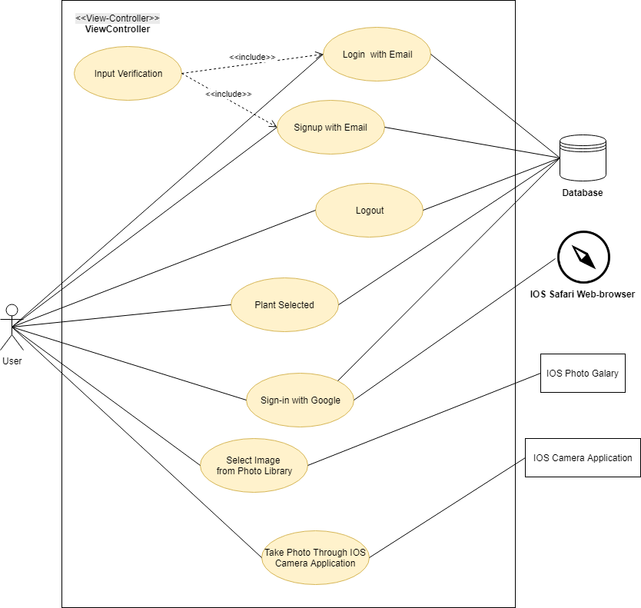
Requirements: Use Cases
Use Case Diagram:
Notes:
5 seconds
Show the Use Case Diagram for the whole project. Highlight your use cases.

Slide 5
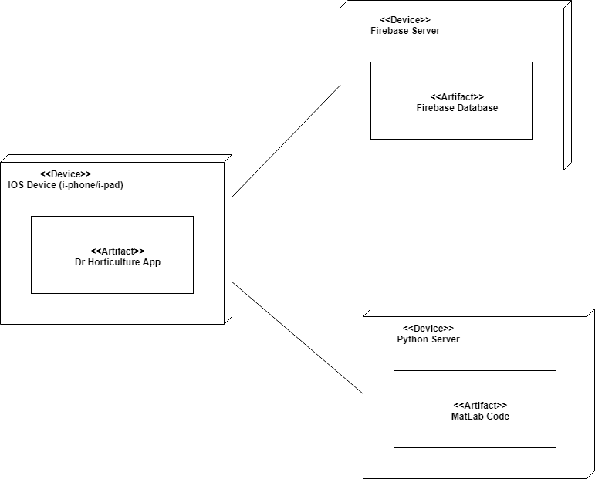
System Design: Architecture
Architectural Patterns used to design the system:
Model-View-Controller: used for the designing of the applications user interface (front-end)
Client-Server: used in designing both the database and server (back-end)
System Deployment:
Notes:
20 seconds
System design: Highlight the parts that you contributed to them.
1. System decomposition; identify the architecture patterns used
2. System deployment – h/w and s/w requirements

Slide 6
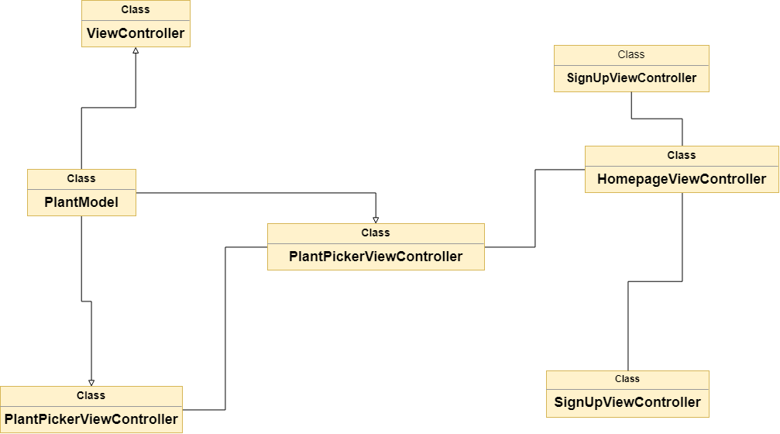
Minimal Class Diagram
Notes:
10 seconds.Minimal class diagram. Highlight the classes that you created/modified
Identify the design patterns used (one or more slides).

Slide 7
User Stories
1. #674-Implement User Authentication (Login/Signup)
2. #672-Integrate Firebase Database
3. #671-Add Camera Function & Image Selection
4. #668-Create Plant Selection View
5. #677-Create Fertilizer Recommendation View
6. #673-Improve the App’s Appearance & Layout
7. #670-Create Tab-Navigation & Navigation Controllers
8. #667-Create Homepage
Notes:
5 seconds.
List the user stories that you worked on them.(put in order of importance). Stay focused on the parts that you have been working.

Slide 8
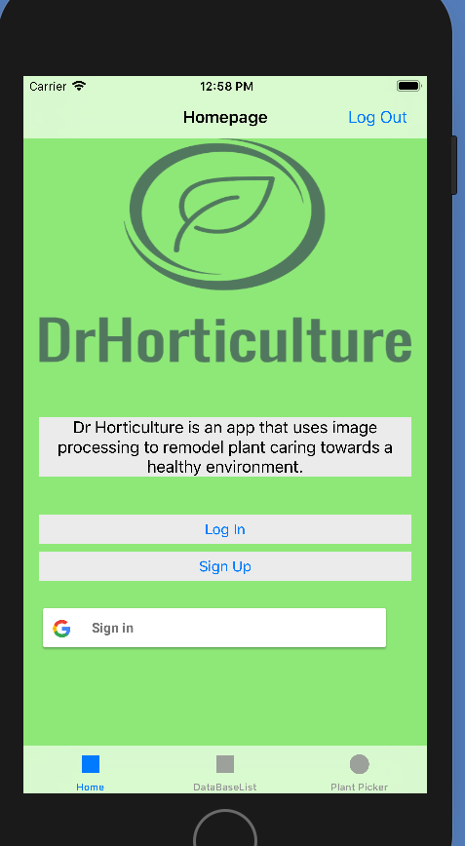
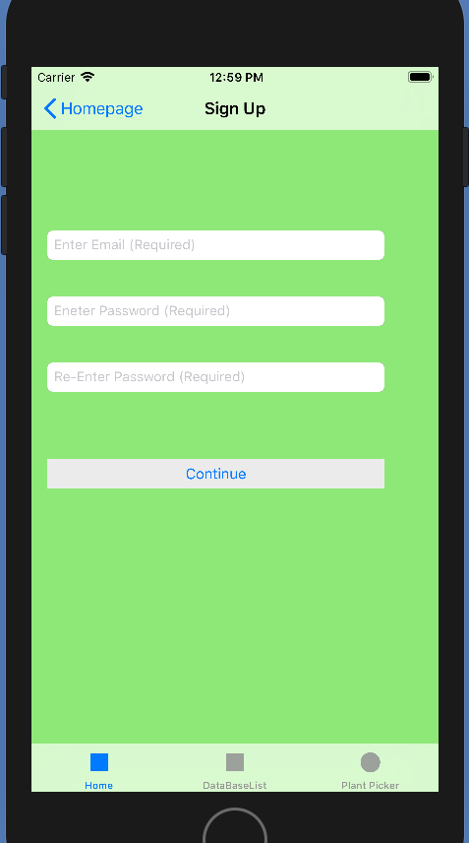
User Story #674
Implement User Authentication
Description:
As a product owner, I would like to have users login, so that monetization can be implemented later on as well as allow for user statistics to be generated
Acceptance Criteria:
Users are able to signup
Users are able to login
Users can logout
Notes:
60 seconds
The tile of user story
The most important user story you worked on it. You have to describe this one very well and be proud of that.
Please present and show the complexity of your work, code, algorithms, and technical challenges and technologies you have used. (you could use screenshot if you want. Visual presentations are better than text presentation)
Go into the details of the most important/significant tasks using bullet lists or visual graphs or state chart diagram
Sequence Diagram for this user story is mandatory (in another separate page if required)
Demo using screenshots or GIF (in another separate page if required)

Slide 9
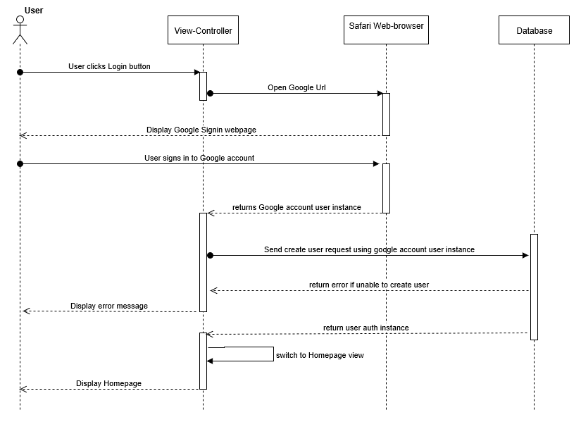
User Story #674
Implement User Authentication
Sequence Diagram for one of the user story’s use cases.
Notes:
60 seconds
The tile of user story
The most important user story you worked on it. You have to describe this one very well and be proud of that.
Please present and show the complexity of your work, code, algorithms, and technical challenges and technologies you have used. (you could use screenshot if you want. Visual presentations are better than text presentation)
Go into the details of the most important/significant tasks using bullet lists or visual graphs or state chart diagram
Sequence Diagram for this user story is mandatory (in another separate page if required)
Demo using screenshots or GIF (in another separate page if required)

Slide 10
User Story #672
Integrate Firebase Database
Description:
As a developer, I would like to have a database setup with the plant data, so that the application can load the latest and most up to date plant data for plant selection and fertilizer recommendations
Acceptance Criteria:
Firebase properly installed in the system along with the corresponding cocoa pods
The real time database is set up on the Firebase console
The data is queried and displayed on the application
Notes:
20 seconds
The tile of user story
Please present and show the complexity of your work, code, algorithms, and technical challenges and technologies you have used. (you could use screenshot if you want. Visual presentations are better than text presentation) - Go into the details of the most important/significant tasks using bullet lists or visual graphs or state chart diagram - Demo using screenshots or GIF (in another separate page if required)
Sequence Diagram for this user story is optional

Slide 11
User Story #671
Add Camera Functionality and Image
Description:
As a Developer, I would like to allow users select existing images from their photo gallery, so that they can upload it to the server for results.
As a Developer, I would like to allow users invoke the camera app., so that they can take a photo of the plant and upload it to the server for results.
Acceptance Criteria:
View for image selection/tacking is rendering properly
User is able to set the weeks since planted dropdown menu
User is able to select an image from their photo library
Image selected appears in the image view as a preview
Notes:
20 seconds
The tile of user story
Please present and show the complexity of your work, code, algorithms, and technical challenges and technologies you have used. (you could use screenshot if you want. Visual presentations are better than text presentation) - Go into the details of the most important/significant tasks using bullet lists or visual graphs or state chart diagram - Demo using screenshots or GIF (in another separate page if required)
Sequence Diagram for this user story is optional

Slide 12
User Story #668
Create Plant Selection View
Description:
As a user, I would like to have a plant selection page. so that I can select the species of plant I plan to use the app for
As a developer, I would like to have navigation buttons on the homepage and plant selection view, so that users can transition from the home page to the plant selection view and back
Acceptance Criteria:
View loads with proper appearance and layout on all IOS devices
Transition form the homepage to the plant selection view occurs correctly
Table view properly loads with the correct data
Selection is correctly displayed with the corresponding plant name
back button properly returns to the homepage
Notes:
20 seconds
The tile of user story
Please present and show the complexity of your work, code, algorithms, and technical challenges and technologies you have used. (you could use screenshot if you want. Visual presentations are better than text presentation) - Go into the details of the most important/significant tasks using bullet lists or visual graphs or state chart diagram - Demo using screenshots or GIF (in another separate page if required)
Sequence Diagram for this user story is optional

Slide 13
User Story #677
Create Fertilizer Recommendation view
Description:
As a developer, I would like for there to be a view to display the fertilizer recommendation, so that the servers response can be displayed to the user
Acceptance Criteria:
View load properly on device sizes
Response is according to specific plant data and server results
Notes:
20 seconds
The tile of user story
Please present and show the complexity of your work, code, algorithms, and technical challenges and technologies you have used. (you could use screenshot if you want. Visual presentations are better than text presentation) - Go into the details of the most important/significant tasks using bullet lists or visual graphs or state chart diagram - Demo using screenshots or GIF (in another separate page if required)
Sequence Diagram for this user story is optional

Slide 14
User Story #673
Improve the App’s Appearance and Layout
Description :
As a product owner, I would like the look and layout of the app to better represent represent the purpose of the app, so that users find confidence in using the app and its fertilizer recommendations
Acceptance Criteria:
The app better reflects the feel and image of the power-point provided by the product owner
The descriptions on the app are better representative of the apps intentions as desired by the product owner
Notes:
20 seconds
The tile of user story
Please present and show the complexity of your work, code, algorithms, and technical challenges and technologies you have used. (you could use screenshot if you want. Visual presentations are better than text presentation) - Go into the details of the most important/significant tasks using bullet lists or visual graphs or state chart diagram - Demo using screenshots or GIF (in another separate page if required)
Sequence Diagram for this user story is optional

Slide 15
User Story #670: Create Tab-Navigation & Navigation Controllers
Description:
As a Developer, I would like to create a tab-bar navigation & navigation controllers, so that users can seamlessly transition from one view to another and back throughout the application
Acceptance Criteria:
Tab view appears in all views with appropriate titles and images for the corresponding tabs
Clicking on the tab changes view to appropriate tab and clicking back on previous tab returns it to the state in which it had previously been in
Navigation title and return buttons properly appear at the top of the application for each view
return buttons on the navigation bar perform transition back to previous view
Notes:
20 seconds
The tile of user story
Please present and show the complexity of your work, code, algorithms, and technical challenges and technologies you have used. (you could use screenshot if you want. Visual presentations are better than text presentation) - Go into the details of the most important/significant tasks using bullet lists or visual graphs or state chart diagram - Demo using screenshots or GIF (in another separate page if required)
Sequence Diagram for this user story is optional

Slide 16
User Story #667
Create Homepage
Description:
As a developer, I would like to have the application open to a homepage, so that users are greeted with a logo, description, and buttons to login and navigate the app.
Acceptance Criteria:
Loads with proper appearance and layout on all IOS devices
Button clicks respond with appropriate interactions
Notes:
20 seconds
The tile of user story
Please present and show the complexity of your work, code, algorithms, and technical challenges and technologies you have used. (you could use screenshot if you want. Visual presentations are better than text presentation) - Go into the details of the most important/significant tasks using bullet lists or visual graphs or state chart diagram - Demo using screenshots or GIF (in another separate page if required)
Sequence Diagram for this user story is optional

Slide 17
Test Suites and Test Cases
Test Case ID | Photo_Lyrary_Permisions
Description/Summary of Test | Test to ensure that app properly request for permission to view photo library
Pre-Condition | The user is in the image picker view and clicks Import Image, & and has not previously granted the app permission
Expected Result | IOS photo library is opened up and request notification pop-up displayed
Actual Result | IOS photo library was opened up with request notification
Status (Pass/Fail) | Pass
Test Case ID | ImportImage_Button_Pressed
Description/Summary of Test | Test to see if ImportImage button callas IOS photo library
Pre-Condition | The user is in the image picker view and clicks Import Image
Expected Result | IOS photo library is opened up
Actual Result | IOS photo library was opened up
Status (Pass/Fail) | Pass
Notes:
10 seconds
A description of verification process and Test Suites and Test Cases for one of the use cases.
1 One sunny day and one rainy day for the implemented use cases (one or more slides).
2 Automated test scripts for the implemented use cases (if any) (one or more slides).

Slide 18



Summary
Dr horticulture is an app that helps to mitigate over fertilization
Any Questions?
Thank You!
Jose Nunez, emai: jnune123@fiu.edu
Notes:
10 seconds
Summarize your contribution, mention your effort for Scrum, Mingle, Github, Google Drive Documentation and minutes
Include your contact information
Ask if anyone has any questions for you.
Thank your audience

